Slide 1
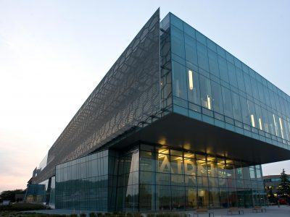
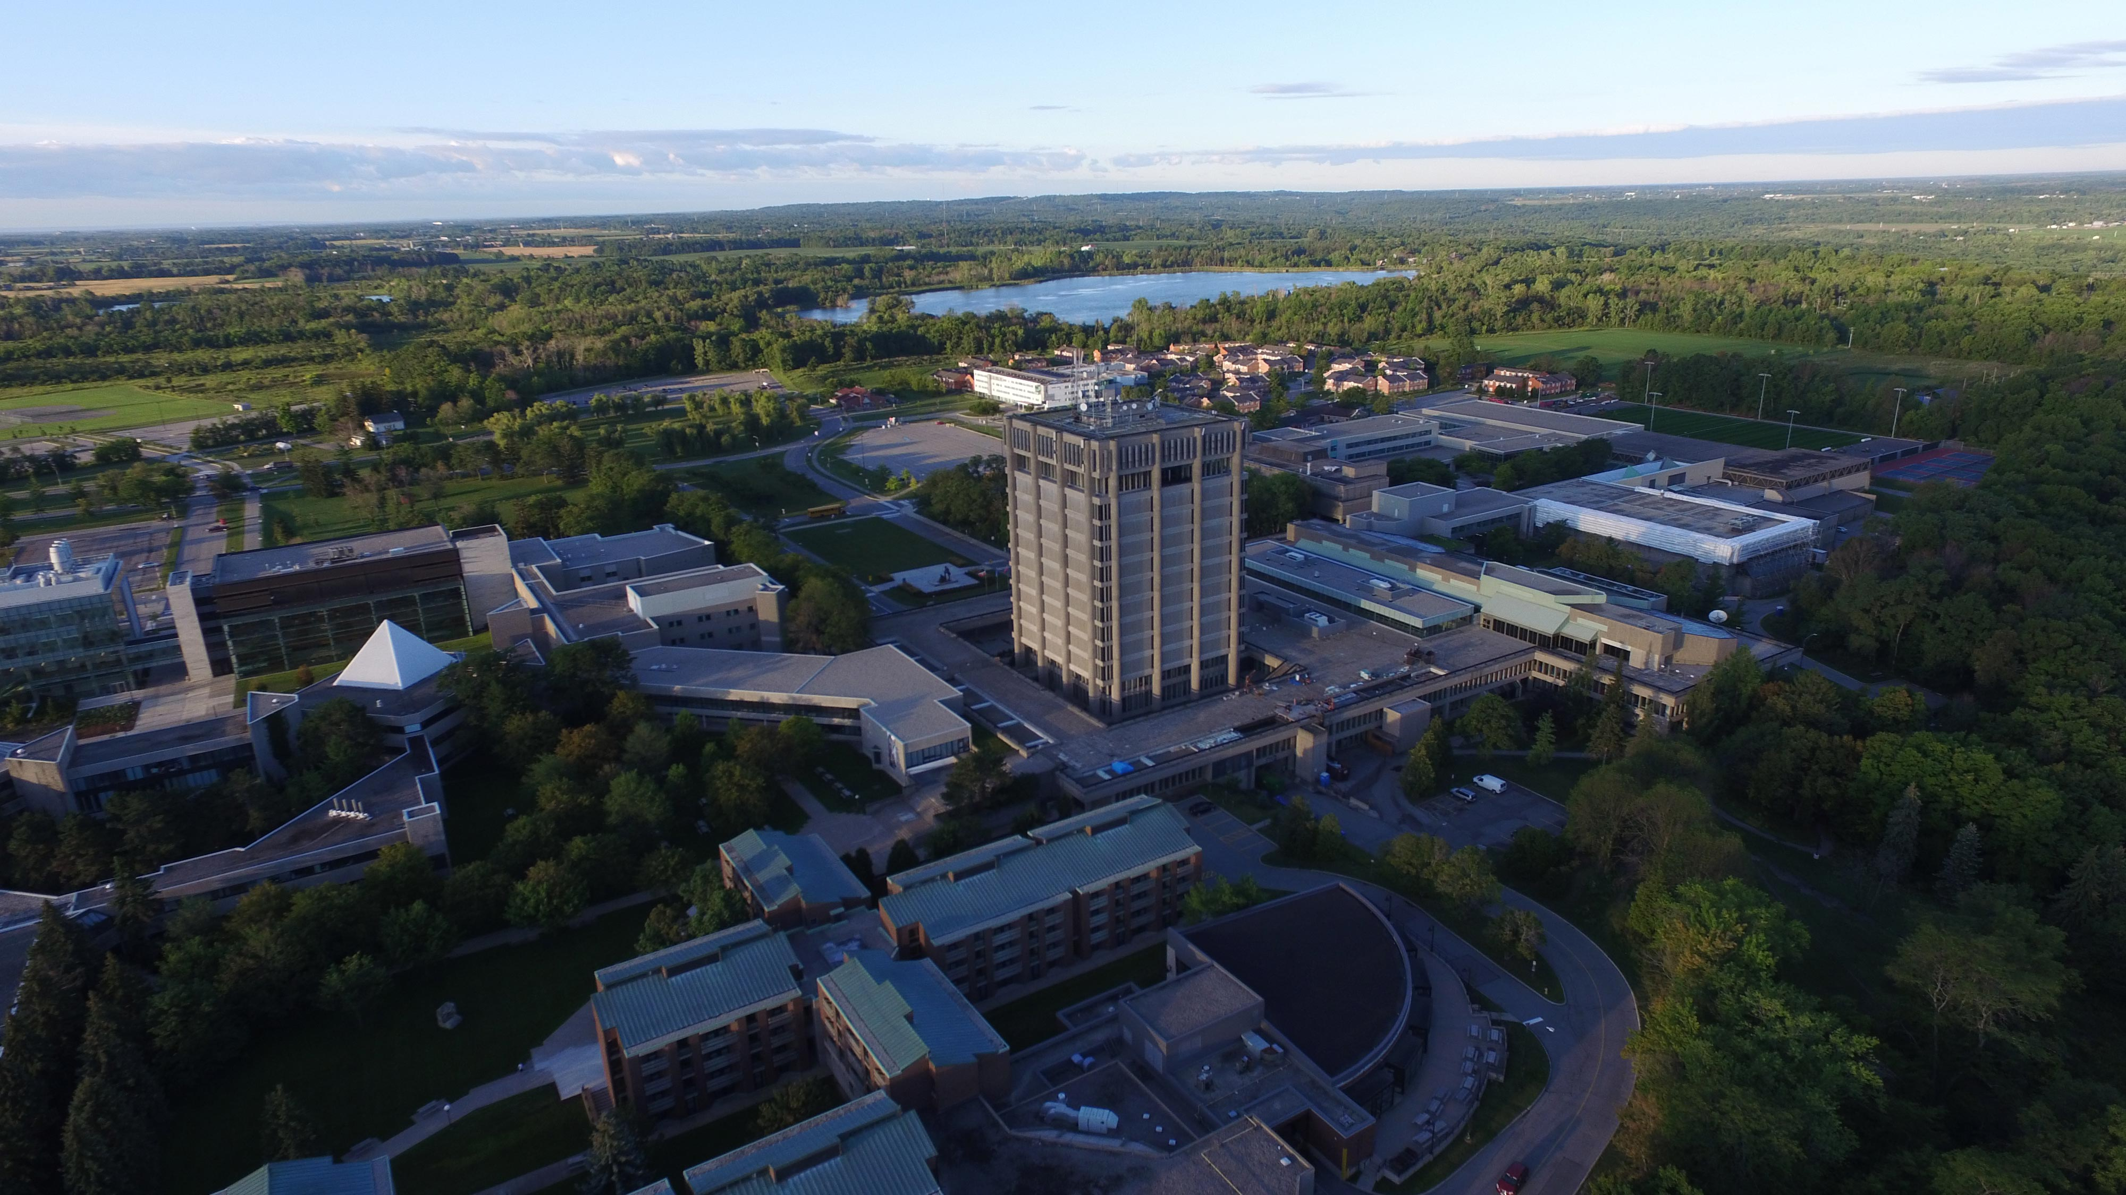


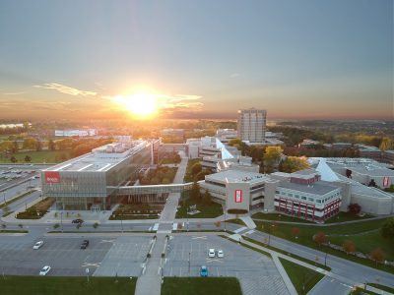
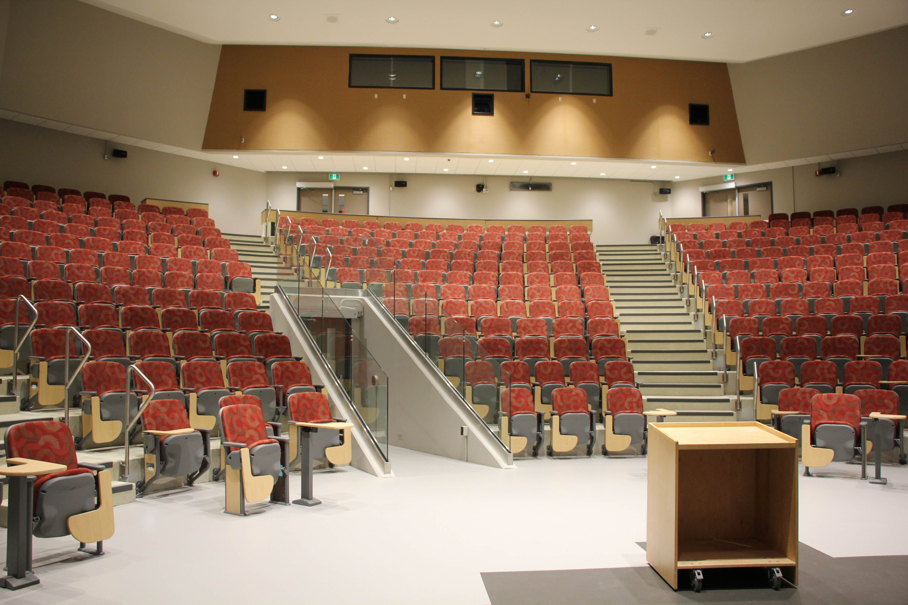
OE3C 2026 May 14-16, 2026 Brock University

Slide 2
OE3C 2026 May 14-16, 2026 Brock University

Slide 3
OE3C 2026 May 14-16, 2026 Brock University

